Slide 1








NOVASCOPE End-To-End Solutions: Where Biochemistry Meets Semiconductors
NovaAssay
NovaCHIP
NovaBIO
Molecule-agnostic
Cost-effective ASIC
Microfluids-based fast-tracked sample
Buffer system
Enabling Engine
Bio-probes
Surface Treatment
NovaLINK
NovaKIT
EG- FET
Patented chemistry
Proprietary reagents
Probe embedded in surface coating
Cartridge for disposable ASIC
Analyzer for data reading
Detection based on the change of the electric charge distribution at the surface of NovaCHIP after the binding with the analyte
Value-added services
NovaAI
NovaCRO
Smart process
Automation
Test Data
Specimen repository
Certified lab

Slide 2
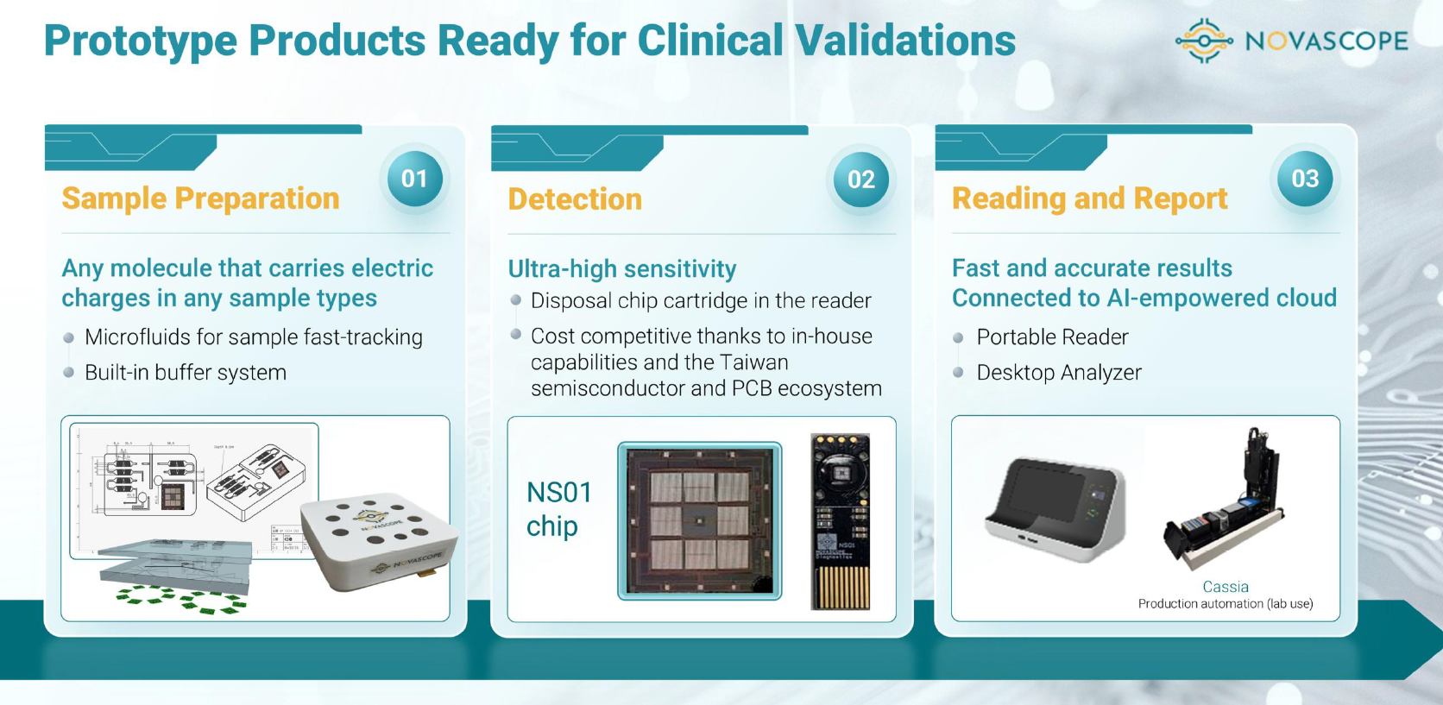

Slide 3

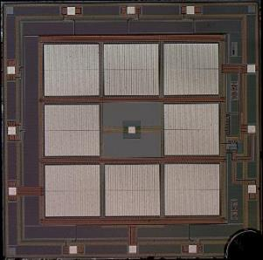





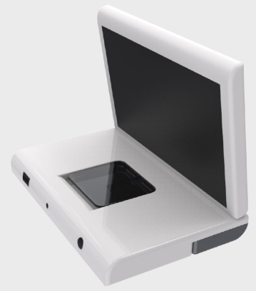
NOVASCOPE Extended-Gate FET (Field Effect Transistor): From Probes to Processors
AI-powered analytics as value added service
I
V
Bare chip
Functional biochip
Apply Sample
Bio-Sensing
Signal Reading
current
Proprietary bioprobe coating
Any molecule that carries electric charges
FET detects change of electricity discharge
Real-time test results
Biochip Design and Production
Automated Process

Slide 4




Biomarker Portfolio Under Development
Field
Probe sorts | NA | Ab & NA | NA | Ab & NA
Biomarker Probes (Ab/NA) | E. faecium A. baumannii K. pneumoniae E. coli E. faecalis P. aeruginosa S. aureus | pTau 181/217/231 NfL GFAP S100B TDP-43 α-synuclein Amyloid beta 40/42 APOE4 (NA) | EGFR ALK ROS1 BRAF NTRK RET K-RAS METex14 | PRRSV PEDV PCV1/2/3/4 CSFV PRV SB
Infection
Dementia
Liquid Biopsy
Animals &
Food Safety

Slide 5

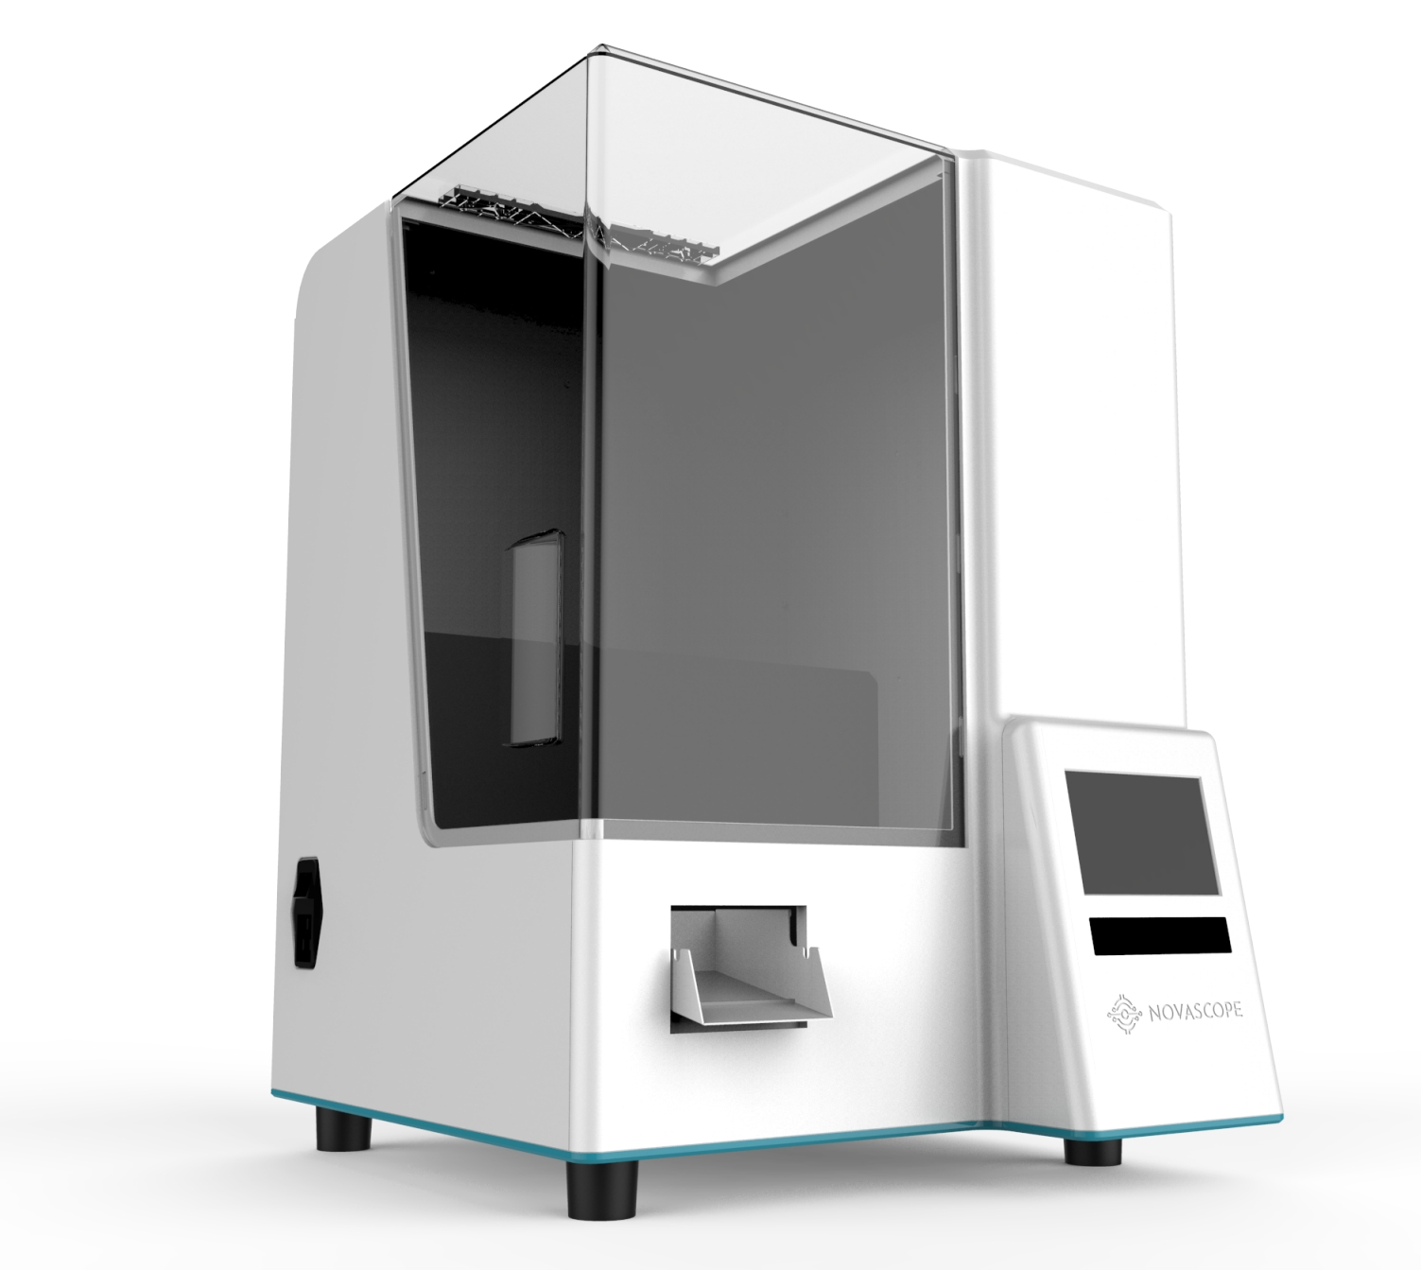




Novascope NVDFlow™ Automated BioChip Platform System
→ A flexible, validated BioChip workflow ready for real-world clinical integration.
Operational
flexibility
Cross-platform verified
(Benchmarking vs SIMOA)
Sample-to-Answer
(same-day result)
Bench-top
(~20KG)
Resource-efficient

Slide 6

Please insert my pic and change my job title to “Finance & IR Director”

